Slide 1
Deep Learning
CS473/CS573: Computer Vision

Slide 2
What is Deep Learning?

Slide 3
What is Deep Learning?
The goal of deep learning is to obtain a function that answers a specific question.

Slide 4
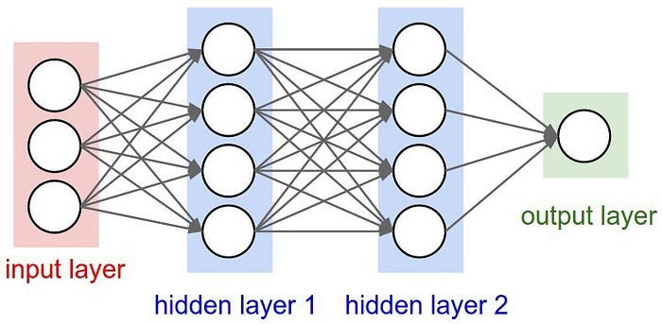
What is Deep Learning?
The goal of deep learning is to obtain a function that answers a specific question.
Deep
Function is multi-layered

Slide 5
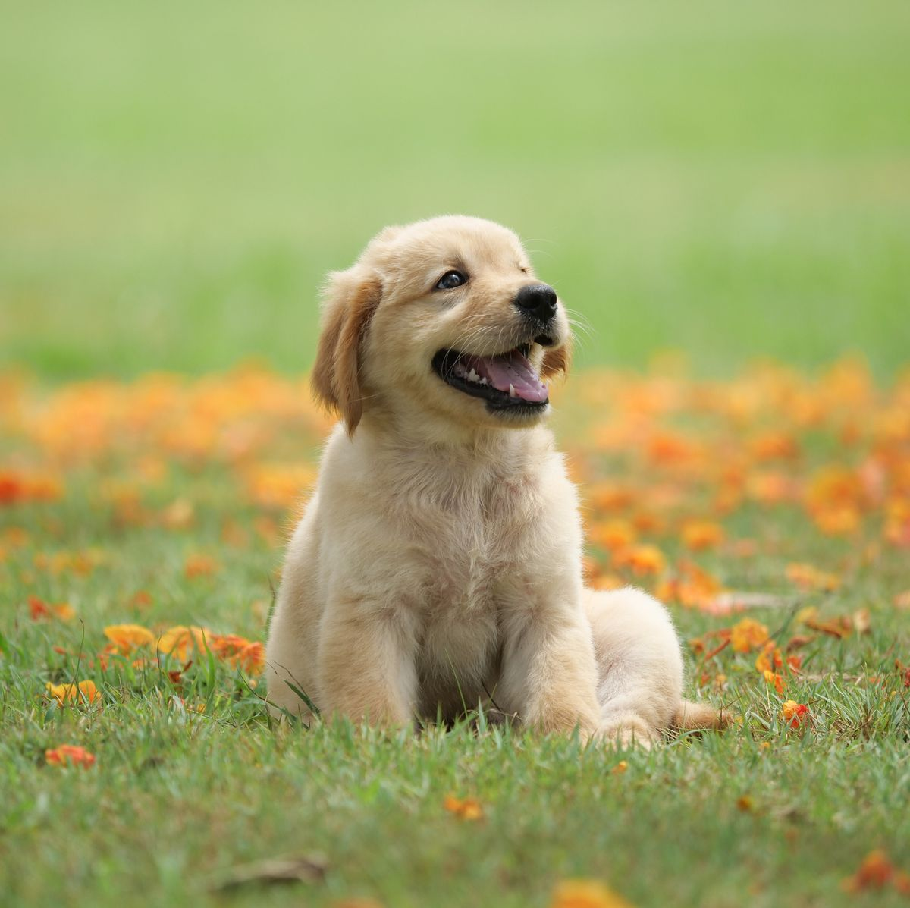

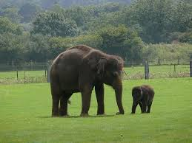
What is Deep Learning?
The goal of deep learning is to obtain a function that answers a specific question.
dog
cat
elephant
Deep
Learning
Function is multi-layered
Function is estimated from data

Slide 6
Machine Learning
How do machines learn?

Slide 7
Machine Learning
How do machines learn?
Feature Extraction followed by Feature Reasoning

Slide 8
Machine Learning
How do machines learn?
Feature Extraction followed by Feature Reasoning
Example: Let’s answer a specific question:

Slide 9
Machine Learning
How do machines learn?
Input
What animal is in this image?

Slide 10
Machine Learning
How do machines learn?
Feature Extractor
Input
What animal is in this image?

Slide 11
Machine Learning
How do machines learn?
Grey
4 Legs
Feature Extractor
…
Trunk
Input
Feature Vector
What animal is in this image?

Slide 12
Machine Learning
How do machines learn?
Grey
4 Legs
Feature Extractor
Feature Reasoning
…
Trunk
Input
Feature Vector
What animal is in this image?

Slide 13
Machine Learning
How do machines learn?
Grey
4 Legs
Feature Extractor
Feature Reasoning
Elephant
…
Trunk
Input
Feature Vector
Output
What animal is in this image?

Slide 14
Machine Learning
How do machines learn?
Grey
4 Legs
Feature Extractor
Feature Reasoning
Elephant
…
Trunk
Input
Feature Vector
Output
What animal is in this image?

Slide 15
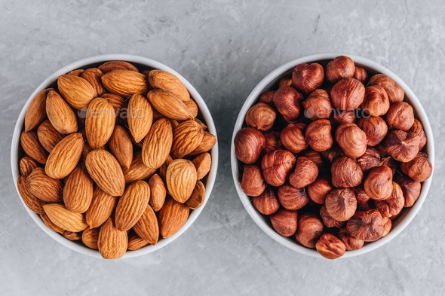
Feature Extraction
Example: let’s classify hazelnuts and almonds

Slide 16
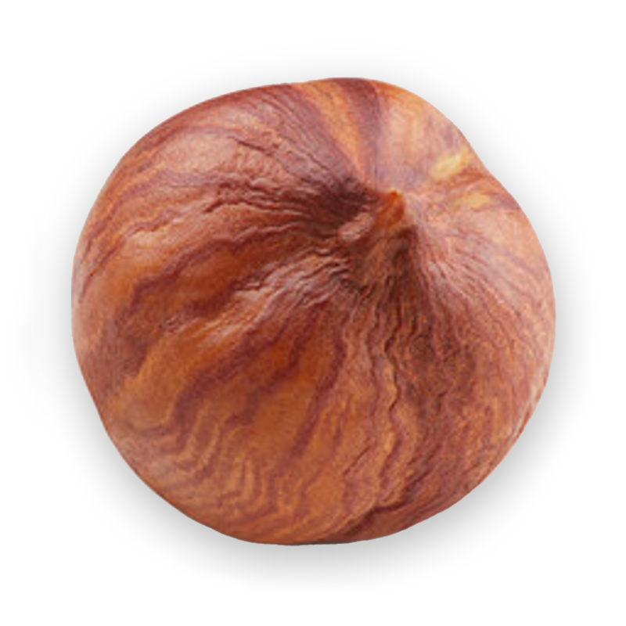
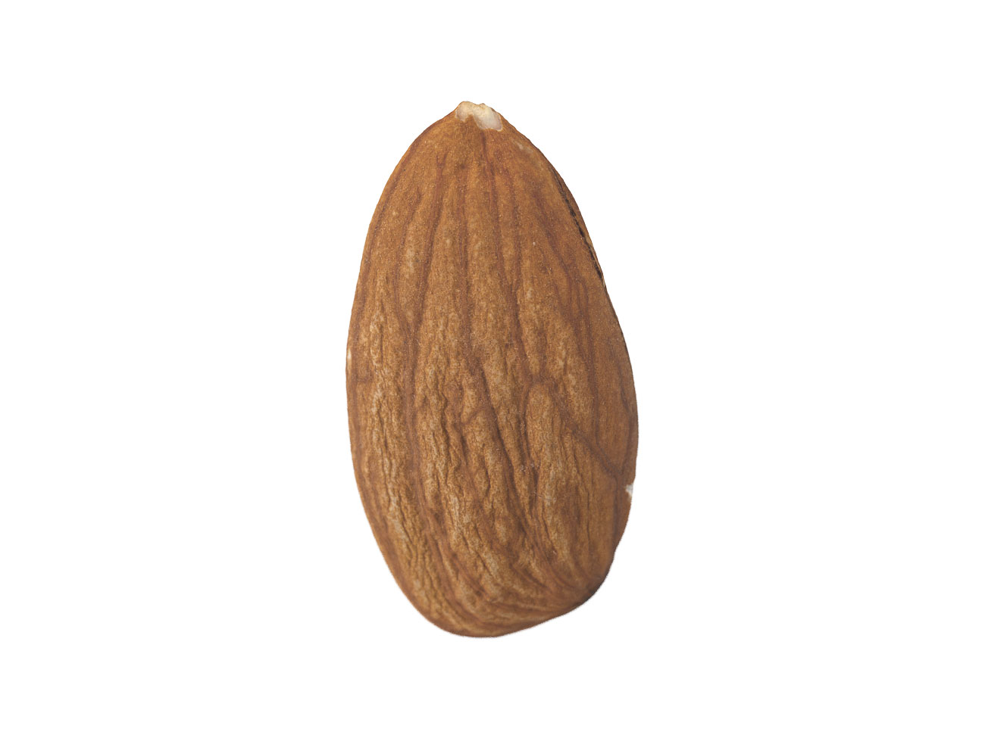
Feature Extraction
Example: let’s classify hazelnuts and almonds

Slide 17
Feature Extraction
Example: let’s classify hazelnuts and almonds

Slide 18
Feature Extraction
Example: let’s classify hazelnuts and almonds

Slide 19
Feature Extraction
Example: let’s classify hazelnuts and almonds
Major Axis
Minor Axis

Slide 20
Feature Extraction
Example: let’s classify hazelnuts and almonds
Major Axis
Minor Axis
Hazelnuts vs Almonds

Slide 21
Feature Extraction
Example: let’s classify hazelnuts and almonds
Hazelnuts
Major Axis
Minor Axis
Hazelnuts vs Almonds

Slide 22
Feature Extraction
Example: let’s classify hazelnuts and almonds
Almonds
Hazelnuts
Major Axis
Minor Axis
Hazelnuts vs Almonds

Slide 23
Feature Extraction
Example: let’s classify hazelnuts and almonds
Major Axis
Minor Axis
Hazelnuts vs Almonds

Slide 24
Feature Extraction
Example: let’s classify hazelnuts and almonds
How do we obtain this line?
Need Machine Learning
Major Axis
Minor Axis
Hazelnuts vs Almonds

Slide 25
Machine Learning
Grey
4 Legs
Feature Extractor
Feature Reasoning
Elephant
…
Trunk
Input
Feature Vector
Output
What animal is in this image?

Slide 26
Machine Learning
Decision Boundary for Binary Classification
Linear Boundary

Slide 27
Machine Learning
Decision Boundary for Binary Classification
Major Axis
Linear Boundary
Minor Axis
Hazelnuts vs Almonds

Slide 28
Machine Learning
Decision Boundary for Binary Classification
Major Axis
Linear Boundary
Minor Axis
Linear Support Vector Machine
Hazelnuts vs Almonds

Slide 29
Machine Learning
Decision Boundary for Binary Classification
Linear Boundary
Axis Aligned Non-Linear Boundary
Linear Support Vector Machine
Decision Tree

Slide 30
Machine Learning
Decision Boundary for Binary Classification
Linear Boundary
Axis Aligned Non-Linear Boundary
Complex Non-Linear Boundary
Linear Support Vector Machine
Decision Tree
Neural Network

Slide 31
When Should You Use Deep Learning?
Classical Machine Learning | Deep Learning
Interpretability and explainability is a priority. | Very high accuracy is a priority.
Smaller amounts of relatively simple data. | Large amounts of precisely labeled data.
Straightforward feature engineering. | Complex feature engineering.
https://blog.dataiku.com/when-and-when-not-to-use-deep-learning

Slide 32
When Should You Use Deep Learning?
Classical Machine Learning | Deep Learning
Interpretability and explainability is a priority. | Very high accuracy is a priority.
Smaller amounts of relatively simple data. | Large amounts of precisely labeled data.
Straightforward feature engineering. | Complex feature engineering.
K-Means Clustering
Linear Regression
Decision Trees
Random Forest
Fully Connected Network
Convolutional Neural Network
https://blog.dataiku.com/when-and-when-not-to-use-deep-learning

Slide 33
When Should You Use Deep Learning?
Grey
4 Legs
Feature Extractor
Feature Reasoning
Elephant
…
Trunk
Input
Feature Vector
Output
What animal is in this image?

Slide 34
When Should You Use Deep Learning?
Grey
4 Legs
Feature Extractor
Feature Reasoning
Elephant
…
Deep Learning
Trunk
Input
Feature Vector
Output
What animal is in this image?

Slide 35
Deep Learning for Computer Vision
What specific questions can we answer?
Circa 1966: Marvin Minsky at MIT gives Gerald Jay Sussman, an undergraduate student, a summer project to link a computer to a camera and get the computer to “describe what it saw”.

Slide 36
Deep Learning for Computer Vision
What specific questions can we answer?
Circa 1966: Marvin Minsky at MIT gives Gerald Jay Sussman, an undergraduate student, a summer project to link a computer to a camera and get the computer to “describe what it saw”.
How would you describe this image?

Slide 37
Deep Learning for Computer Vision
What specific questions can we answer?
Circa 1966: Marvin Minsky at MIT gives Gerald Jay Sussman, an undergraduate student, a summer project to link a computer to a camera and get the computer to “describe what it saw”.
How would you describe this image?
First: What does “describe this” even mean?

Slide 38
Deep Learning for Computer Vision
Deep Learning Tasks
Binary Classification (binary label):
“Is there an elephant in this image?”
Yes

Slide 39
Deep Learning for Computer Vision
Deep Learning Tasks
Binary Classification (binary label):
“Is there an elephant in this image?”
Classification (integer label):
“What animal is in this image?”
An Elephant

Slide 40
Deep Learning for Computer Vision
Deep Learning Tasks
Binary Classification (binary label):
“Is there an elephant in this image?”
Classification (integer label):
“What animal is in this image?”
Regression (real number):
“How old is the elephant in this image?”
10.5 Years

Slide 41
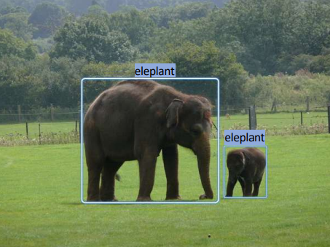
Deep Learning for Computer Vision
Deep Learning Tasks
Binary Classification (binary label):
“Is there an elephant in this image?”
Classification (integer label):
“What animal is in this image?”
Regression (real number):
“How old is the elephant in this image?”
Detection (bounding box):
“Where is the elephant in this image?”

Slide 42
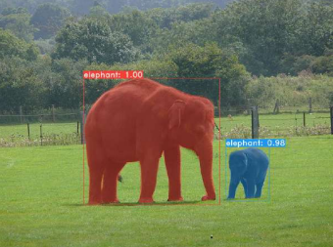
Deep Learning for Computer Vision
Deep Learning Tasks
Binary Classification (binary label):
“Is there an elephant in this image?”
Classification (integer label):
“What animal is in this image?”
Regression (real number):
“How old is the elephant in this image?”
Detection (bounding box):
“Where is the elephant in this image?”
Segmentation (pixel mask):
“Which pixels in this image are elephant?”

Slide 43
Deep Learning for Computer Vision
We know what specific questions we can ask.
But how do we get a computer to answer them?

Slide 44
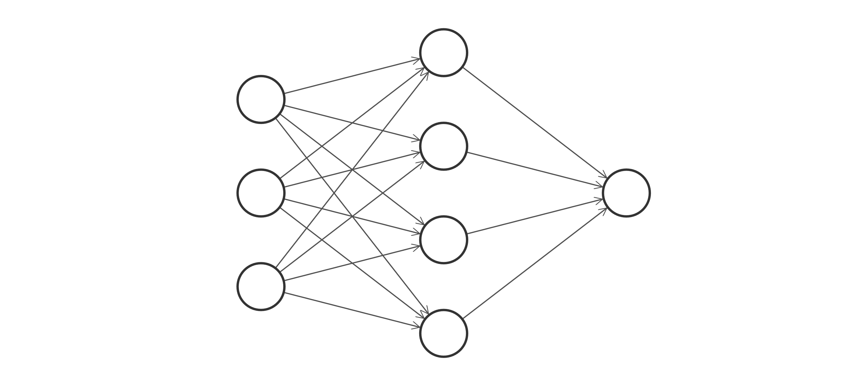
Neural Networks
Fully Connected Network (FCN)
Idea: learn a bunch of functions that make incrementally more complex decisions.

Slide 45
Neural Networks
Fully Connected Network (FCN)
input layer
input your data here

Slide 46
Neural Networks
Fully Connected Network (FCN)
input layer
hidden layer
extract some features and do some reasoning

Slide 47
Neural Networks
Fully Connected Network (FCN)
input layer
hidden layer
output layer
make a decision

Slide 48
Neural Networks
Fully Connected Network (FCN)
input layer
hidden layer
output layer

Slide 49
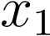
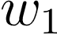
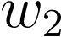

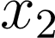

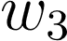
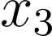
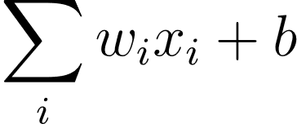
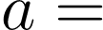
Neural Networks
Building Blocks: Perceptron
Output
(linear)
Inputs
Weights
Bias

Slide 50
Neural Networks
Building Blocks: Perceptron
Output
(linear)
Inputs
Weights
Bias

Slide 51
Neural Networks
Building Blocks: Perceptron
Output
(linear)
Inputs
Weights
Bias

Slide 52
Neural Networks
Building Blocks: Perceptron
Output
(linear)
Inputs
Weights
Bias

Slide 53

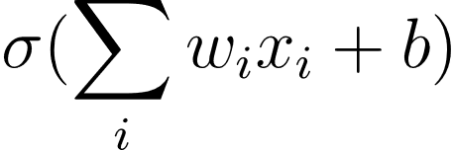
Neural Networks
Building Blocks: Perceptron
Output:
(non-linear)
Activation Function
Inputs
Weights
Bias

Slide 54
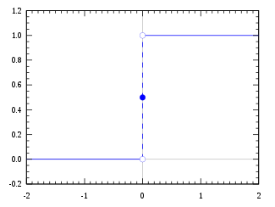
Neural Networks
Building Blocks: Perceptron
Output:
(non-linear)
Activation Function
Inputs
Weights
Bias

Slide 55
Neural Networks
Building Blocks: Perceptron
Neurons (or Nodes) are based on biological neurons that “fire” if the linear output is high. The “firing” is modeled by the activation function.
Output:
(non-linear)
Activation Function
Inputs
Weights
Bias

Slide 56
Neural Networks
Building Blocks: Perceptron
Neurons (or Nodes) are based on biological neurons that “fire” if the linear output is high. The “firing” is modeled by the activation function.
Output:
(non-linear)
Activation Function
Neurons correspond to feature descriptors that “fire” when the “see” their corresponding feature.
Inputs
Weights
Bias

Slide 57
Neural Networks
Building Blocks: Perceptron
Neurons (or Nodes) are based on biological neurons that “fire” if the linear output is high. The “firing” is modeled by the activation function.
Output:
(non-linear)
Activation Function
Neurons correspond to feature descriptors that “fire” when the “see” their corresponding feature.
Inputs
Weights
Bias

Slide 58
Neural Networks
Building Blocks: Perceptron
Neurons (or Nodes) are based on biological neurons that “fire” if the linear output is high. The “firing” is modeled by the activation function.
Output:
(non-linear)
Activation Function
Neurons correspond to feature descriptors that “fire” when the “see” their corresponding feature.
Inputs
Weights
Bias

Slide 59
Neural Networks
String many functions together to answer “reason” about the input
input layer
hidden layer
output layer

Slide 60
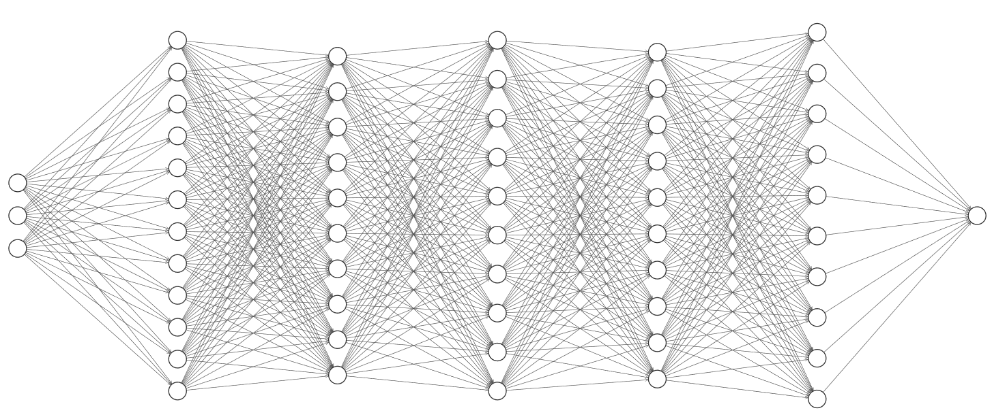
Neural Networks
String many functions together to answer “reason” about the input
input layer
output layer
increasing “reasoning”

Slide 61
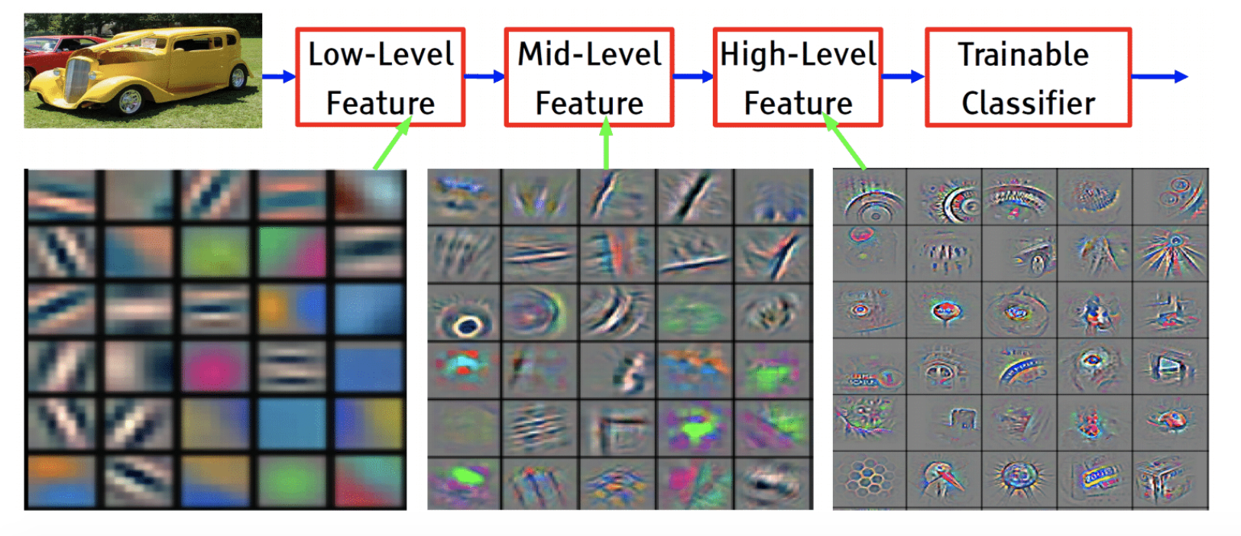
Neural Networks
String many functions together to answer “reason” about the input

Slide 62
Neural Networks
Building Blocks: Network Size
How many nodes/layers should I use?
“Width and depth are both important and should be carefully tuned… depth may determine the abstraction level but the width may influence the loss of information in the forwarding pass.”
https://proceedings.neurips.cc/paper/2017/file/32cbf687880eb1674a07bf717761dd3a-Paper.pdf

Slide 63
Neural Networks
Building Blocks: Network Size
How many nodes/layers should I use?
“Width and depth are both important and should be carefully tuned… depth may determine the abstraction level but the width may influence the loss of information in the forwarding pass.”
At a minimum you should have more nodes than the dimensionality of your input.
https://proceedings.neurips.cc/paper/2017/file/32cbf687880eb1674a07bf717761dd3a-Paper.pdf

Slide 64
Convolutional Neural Network
How do we input images to a Neural Network?
Can’t use a FCN

Slide 65
Convolutional Neural Network
How do we input images to a Neural Network?
Let’s input a 128x128 image
Need 16,384 input nodes
Assume 3 layers with 16,384 nodes each
Can’t use a FCN
(16,384x2x16,384)x3 + 2x16,384 = 1.6 billion
This is not trainable in a reasonable amount of time
Does not model inherent structure of images

Slide 66
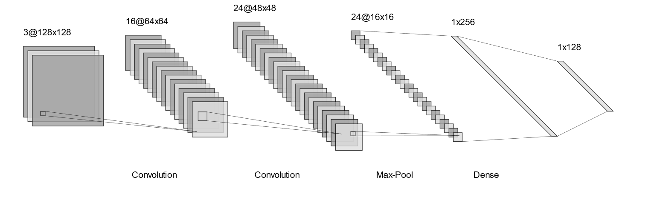
Convolutional Neural Network

Slide 67
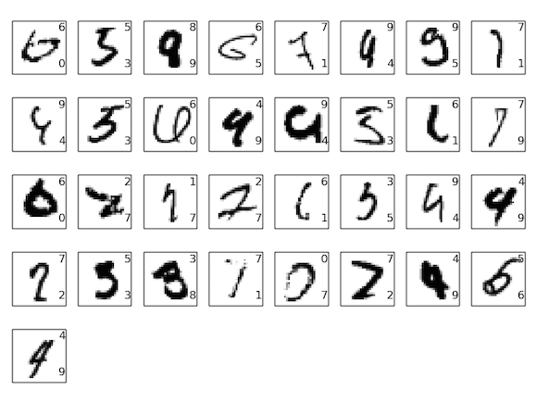
Convolutional Neural Network
MNIST as an example (28x28px) images

Slide 68
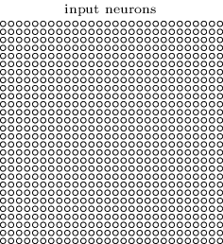
Convolutional Neural Network
(28x28)
Input Values

Slide 69
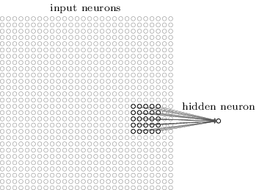
Convolutional Neural Network
have each hidden neuron process a small window of the input, called the “receptive field”.
Grid of weights we multiply by the input to get a single output value
(5x5)
(28x28)
Input Values

Slide 70
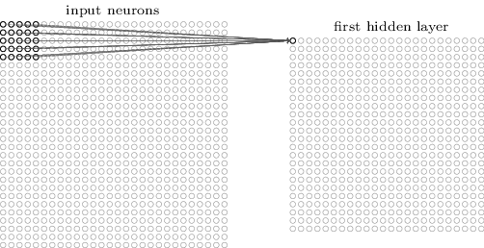
Convolutional Neural Network
have each hidden neuron process a small window of the input, called the “receptive field”.
Slide the receptive field across the image.
(24x24)
(28x28)
Input Values
Output Values

Slide 71
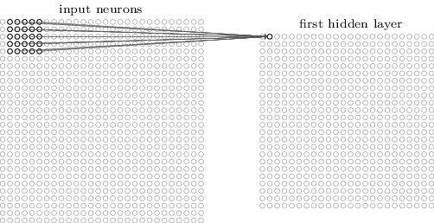
Convolutional Neural Network
have each hidden neuron process a small window of the input, called the “receptive field”.
Slide the receptive field across the image.
Same Weights (Kernel)
Kernel (or Filter): the weights applied inside the receptive field to obtain the next layer output.
(24x24)
(28x28)
Input Values
Output Values

Slide 72
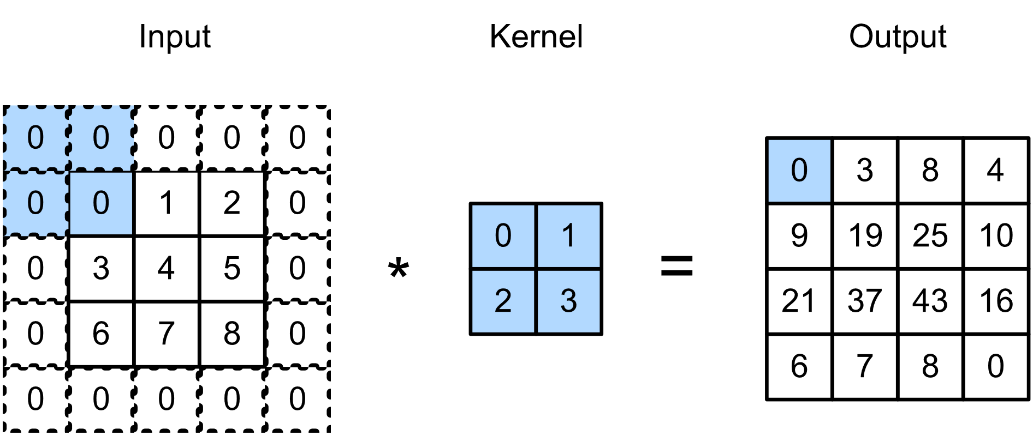
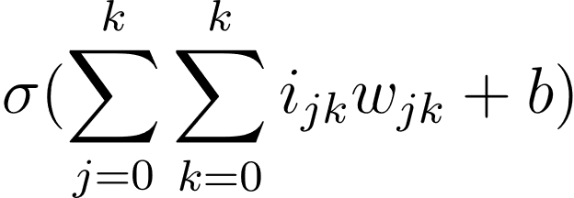
Convolutional Neural Network
Same Weights (kernel)
rows
cols
img
weights
bias
(24x24)
(28x28)
https://d2l.ai/chapter_convolutional-neural-networks/why-conv.html

Slide 73
Convolutional Neural Network
Same Weights (kernel)
`
`
rows
cols
img
weights
bias
(24x24)
(28x28)
https://d2l.ai/chapter_convolutional-neural-networks/why-conv.html

Slide 74
Convolutional Neural Network
Same Weights (kernel)
`
`
rows
cols
img
weights
bias
(24x24)
(28x28)
https://d2l.ai/chapter_convolutional-neural-networks/why-conv.html

Slide 75

Convolutional Neural Network

Slide 76
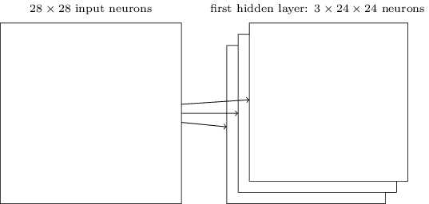
Convolutional Neural Network
Applying 3 filters

Slide 77
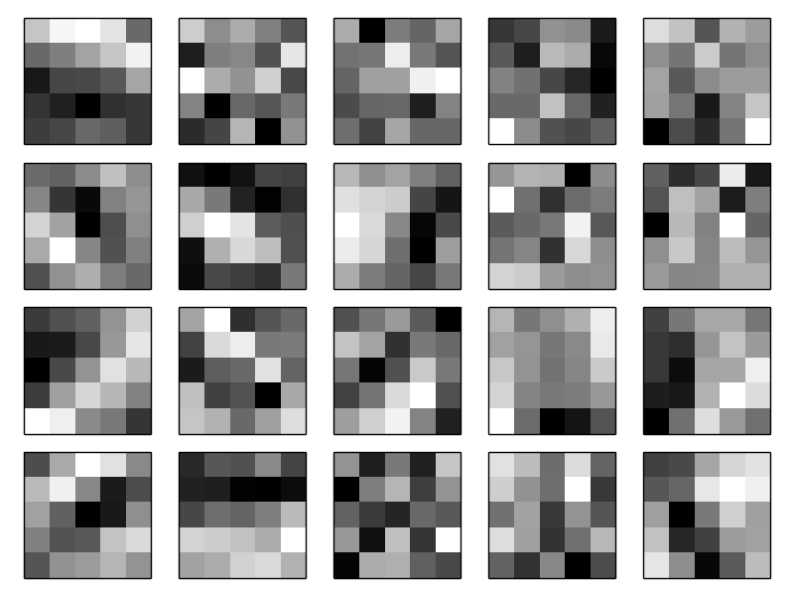
Convolutional Neural Network
Some Learned Filters
Applying 3 filters

Slide 78
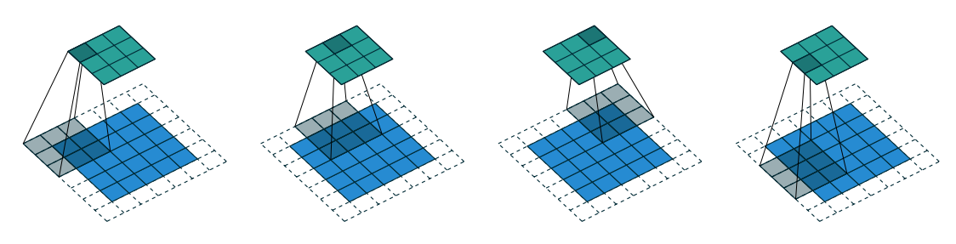
Convolutional Neural Network
Stride: Apply the kernel using a step size.
Padding: Surround the input with a pad value to prevent shrinking of the input.
Dilation: Dilate the kernel to artificially increase
the receptive field.
Stride: 2, Padding: 1, no Dilation
https://arxiv.org/pdf/1603.07285.pdf
https://github.com/vdumoulin/conv_arithmetic/blob/master/README.md

Slide 79
Convolutional Neural Network
Stride: Apply the kernel using a step size.
Stride: 2, Padding: 1, no Dilation
https://arxiv.org/pdf/1603.07285.pdf
https://github.com/vdumoulin/conv_arithmetic/blob/master/README.md

Slide 80
Convolutional Neural Network
Stride: Apply the kernel using a step size.
`
`
Stride: 2, Padding: 1, no Dilation
https://arxiv.org/pdf/1603.07285.pdf
https://github.com/vdumoulin/conv_arithmetic/blob/master/README.md

Slide 81
Convolutional Neural Network
Stride: Apply the kernel using a step size.
`
`
Stride: 2, Padding: 1, no Dilation
https://arxiv.org/pdf/1603.07285.pdf
https://github.com/vdumoulin/conv_arithmetic/blob/master/README.md

Slide 82
Convolutional Neural Network
Stride: Apply the kernel using a step size.
Padding: Surround the input with a pad value to prevent shrinking of the input.
Stride: 2, Padding: 1, no Dilation
https://arxiv.org/pdf/1603.07285.pdf
https://github.com/vdumoulin/conv_arithmetic/blob/master/README.md

Slide 83
Convolutional Neural Network
Stride: Apply the kernel using a step size.
Padding: Surround the input with a pad value to prevent shrinking of the input.
Stride: 2, Padding: 1, no Dilation
https://arxiv.org/pdf/1603.07285.pdf
https://github.com/vdumoulin/conv_arithmetic/blob/master/README.md

Slide 84
Convolutional Neural Network
Stride: Apply the kernel using a step size.
Padding: Surround the input with a pad value to prevent shrinking of the input.
`
Stride: 2, Padding: 1, no Dilation
https://arxiv.org/pdf/1603.07285.pdf
https://github.com/vdumoulin/conv_arithmetic/blob/master/README.md

Slide 85
Convolutional Neural Network
Stride: Apply the kernel using a step size.
Padding: Surround the input with a pad value to prevent shrinking of the input.
`
Stride: 2, Padding: 1, no Dilation
https://arxiv.org/pdf/1603.07285.pdf
https://github.com/vdumoulin/conv_arithmetic/blob/master/README.md

Slide 86
Convolutional Neural Network
Stride: Apply the kernel using a step size.
Padding: Surround the input with a pad value to prevent shrinking of the input.
Dilation: Dilate the kernel to artificially increase
the receptive field.
Stride: 2, Padding: 1, no Dilation
https://arxiv.org/pdf/1603.07285.pdf
https://github.com/vdumoulin/conv_arithmetic/blob/master/README.md

Slide 87
Convolutional Neural Network
Stride: Apply the kernel using a step size.
Padding: Surround the input with a pad value to prevent shrinking of the input.
Dilation: Dilate the kernel to artificially increase
the receptive field.
Stride: 2, Padding: 1, no Dilation
https://arxiv.org/pdf/1603.07285.pdf
https://github.com/vdumoulin/conv_arithmetic/blob/master/README.md

Slide 88
Convolutional Neural Network
Stride: Apply the kernel using a step size.
Padding: Surround the input with a pad value to prevent shrinking of the input.
Dilation: Dilate the kernel to artificially increase
the receptive field.
Stride: 2, Padding: 1, no Dilation
https://arxiv.org/pdf/1603.07285.pdf
https://github.com/vdumoulin/conv_arithmetic/blob/master/README.md

Slide 89
Convolutional Neural Network
Stride: Apply the kernel using a step size.
Padding: Surround the input with a pad value to prevent shrinking of the input.
Dilation: Dilate the kernel to artificially increase
the receptive field.
Stride: 2, Padding: 1, no Dilation

Slide 90
Convolutional Neural Network
Stride: Apply the kernel using a step size.
Padding: Surround the input with a pad value to prevent shrinking of the input.
Dilation: Dilate the kernel to artificially increase
the receptive field.
Stride: 2, Padding: 1, no Dilation
ConvNet Shape Calculator (madebyollin.github.io)

Slide 91
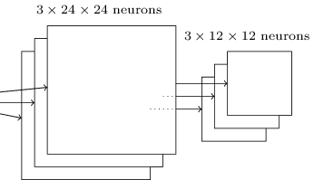
Convolutional Neural Network
Pooling Operation
Max Pooling: Select the most prominent feature in the receptive field.
Applying 3 filters
Applying Max Pooling

Slide 92
Convolutional Neural Network
Pooling Operation
Max Pooling: Select the most prominent feature in the receptive field.
Intuition: Once a feature is found, the precise location isn’t as important.
Helps with dimensionality reduction.
Applying 3 filters
Applying Max Pooling

Slide 93
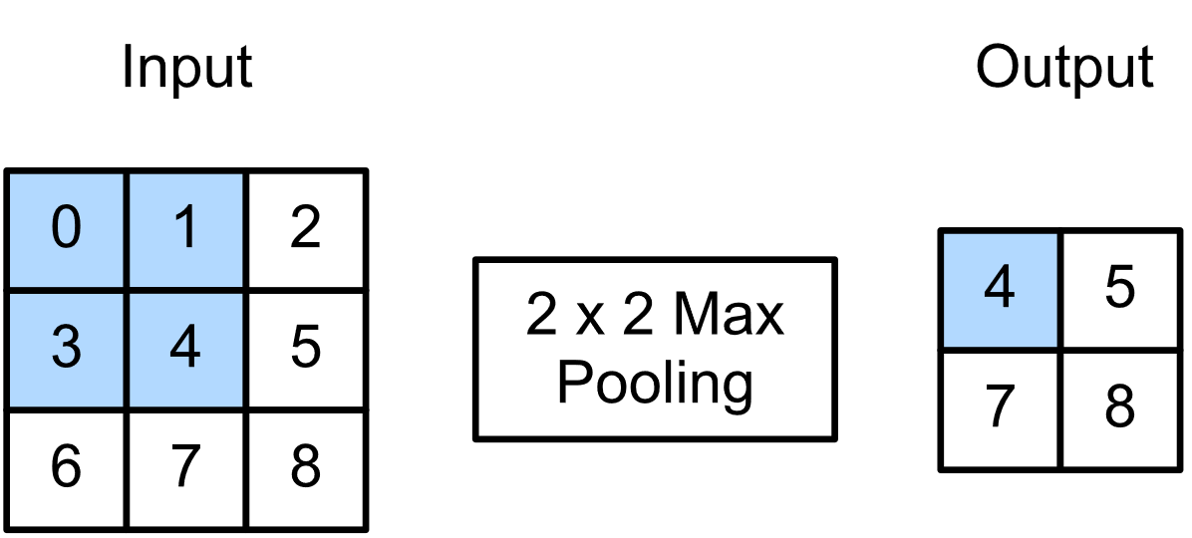
Convolutional Neural Network
Pooling Operation
Max Pooling: Select the most prominent feature in the receptive field.
Intuition: Once a feature is found, the precise location isn’t as important.
Max Pooling: Select the most prominent feature in the receptive field.
Helps with dimensionality reduction.
Applying 3 filters
Applying Max Pooling
https://d2l.ai/chapter_convolutional-neural-networks/pooling.html

Slide 94
Convolutional Neural Network
Pooling Operation
Max Pooling: Select the most prominent feature in the receptive field.
Intuition: Once a feature is found, the precise location isn’t as important.
Max Pooling: Select the most prominent feature in the receptive field.
Helps with dimensionality reduction.
Applying 3 filters
Applying Max Pooling
https://d2l.ai/chapter_convolutional-neural-networks/pooling.html

Slide 95
Convolutional Neural Network
Pooling Operation
Max Pooling: Select the most prominent feature in the receptive field.
Intuition: Once a feature is found, the precise location isn’t as important.
Max Pooling: Select the most prominent feature in the receptive field.
Helps with dimensionality reduction.
Applying 3 filters
Applying Max Pooling
https://d2l.ai/chapter_convolutional-neural-networks/pooling.html

Slide 96
Convolutional Neural Network
Pooling Operation
eye somewhere in here
Max Pooling: Select the most prominent feature in the receptive field.
leg somewhere in here
Intuition: Once a feature is found, the precise location isn’t as important.
Max Pooling: Select the most prominent feature in the receptive field.
Helps with dimensionality reduction.
Applying 3 filters
Applying Max Pooling
https://d2l.ai/chapter_convolutional-neural-networks/pooling.html

Slide 97
Convolutional Neural Network
Typically, we use a combination of layers for the task at hand.
Image classification over 128 classes

Slide 98
Neural Networks
How do we get a network to learn?

Slide 99
Neural Networks
How do we get a network to learn?
Gradient Descent.
Estimate the error.
Compute the change in weights most likely to reduce the error (gradient).
Update the weights according to the gradient.

Slide 100
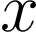
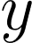
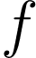
Neural Networks
How do we get a network to learn?
Gradient Descent.
Estimate the error.
Compute the change in weights most likely to reduce the error (gradient).
Update the weights according to the gradient.
network input
ground truth label
network

Slide 101
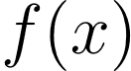
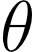
Neural Networks
How do we get a network to learn?
Gradient Descent.
Estimate the error.
Compute the change in weights most likely to reduce the error (gradient).
Update the weights according to the gradient.
network input
ground truth label
network
network output
network parameters (weights and biases)

Slide 102
Neural Networks
How do we get a network to learn?
Gradient Descent.
Estimate the error.
Compute the change in weights most likely to reduce the error (gradient).
Update the weights according to the gradient.
Loss function should be small when the predictions are accurate

Slide 103
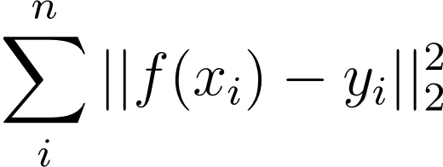
Neural Networks
How do we get a network to learn?
Gradient Descent.
Estimate the error.
Compute the change in weights most likely to reduce the error (gradient).
Update the weights according to the gradient.
Loss function should be small when the predictions are accurate
L2 Loss Function

Slide 104
Neural Networks
How do we get a network to learn?
Gradient Descent.
Estimate the error.
Compute the change in weights most likely to reduce the error (gradient).
Update the weights according to the gradient.
input
label
L2 Loss Function

Slide 105
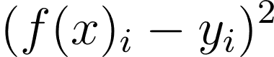
Neural Networks
How do we get a network to learn?
Gradient Descent.
Estimate the error.
Compute the change in weights most likely to reduce the error (gradient).
Update the weights according to the gradient.
Squared L2 Norm
L2 Loss Function

Slide 106
Neural Networks
How do we get a network to learn?
Gradient Descent.
Estimate the error.
Compute the change in weights most likely to reduce the error (gradient).
Update the weights according to the gradient.
Sum over training data
L2 Loss Function

Slide 107
Neural Networks
How do we get a network to learn?
Gradient Descent.
Estimate the error.
Compute the change in weights most likely to reduce the error (gradient).
Update the weights according to the gradient.
What are we optimizing wrt?
L2 Loss Function

Slide 108
Neural Networks
How do we get a network to learn?
Gradient Descent.
Estimate the error.
Compute the change in weights most likely to reduce the error (gradient).
Update the weights according to the gradient.
What are we optimizing wrt?
L2 Loss Function

Slide 109
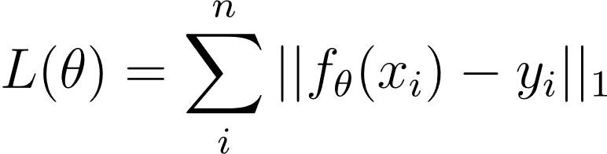
Neural Networks
How do we get a network to learn?
Gradient Descent.
Estimate the error.
Compute the change in weights most likely to reduce the error (gradient).
Update the weights according to the gradient.
What are we optimizing wrt?
L2 Loss Function
https://stats.stackexchange.com/questions/387618/derivative-of-the-loss-function-w-r-t-to-x-for-the-backpropagation

Slide 110
Neural Networks
How do we get a network to learn?
Gradient Descent.
Estimate the error.
Compute the change in weights most likely to reduce the error (gradient).
Update the weights according to the gradient.
What are we optimizing wrt?
L2 Loss Function
Obtain that minimizes L
https://stats.stackexchange.com/questions/387618/derivative-of-the-loss-function-w-r-t-to-x-for-the-backpropagation

Slide 111
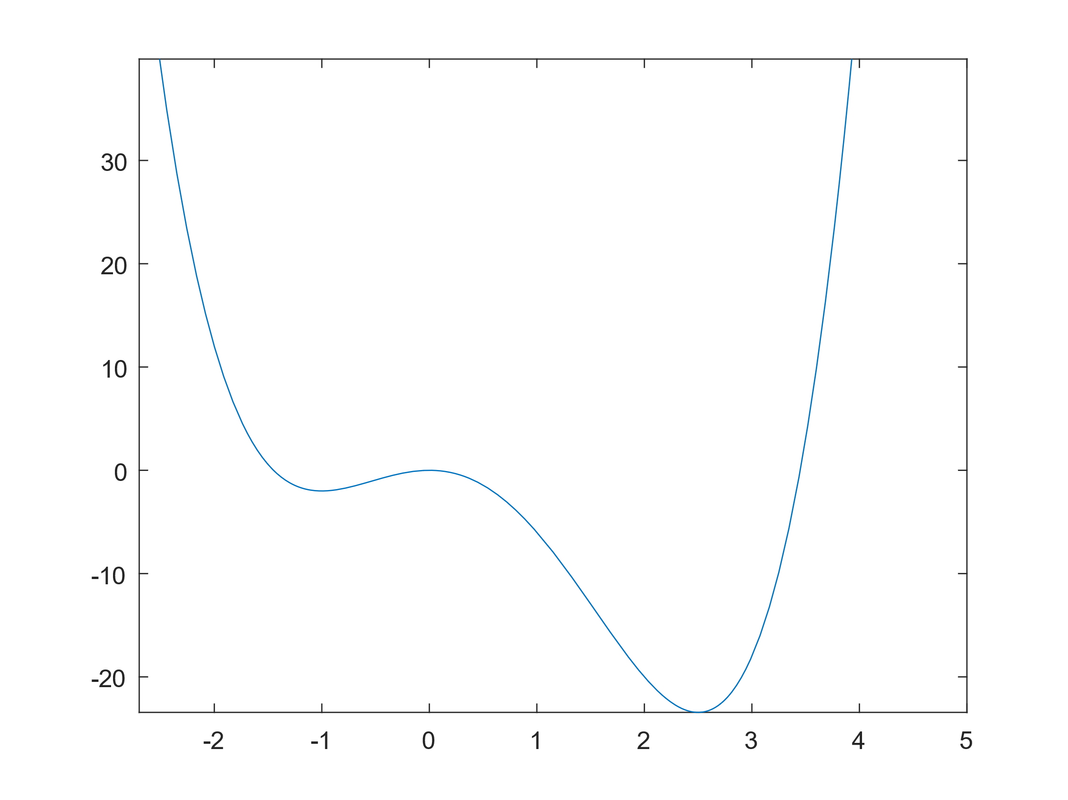
Neural Networks
How do we get a network to learn?
Gradient Descent.
Estimate the error.
Compute the change in weights most likely to reduce the error (gradient).
Update the weights according to the gradient.
Our Loss
Our parameter

Slide 112
Neural Networks
How do we get a network to learn?
Gradient Descent.
Estimate the error.
Compute the change in weights most likely to reduce the error (gradient).
Update the weights according to the gradient.
start

Slide 113
Neural Networks
How do we get a network to learn?
Gradient Descent.
Estimate the error.
Compute the change in weights most likely to reduce the error (gradient).
Update the weights according to the gradient.
start
goal

Slide 114
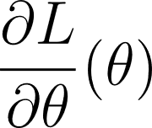
Neural Networks
How do we get a network to learn?
Gradient Descent.
Estimate the error.
Compute the change in weights most likely to reduce the error (gradient).
Update the weights according to the gradient.
start
goal

Slide 115
Neural Networks
How do we get a network to learn?
Gradient Descent.
Estimate the error.
Compute the change in weights most likely to reduce the error (gradient).
Update the weights according to the gradient.
= -36
start
goal
= -2

Slide 116
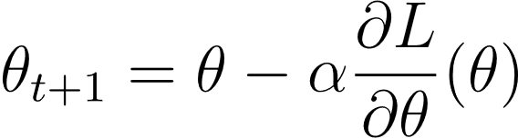
Neural Networks
How do we get a network to learn?
Gradient Descent.
Estimate the error.
Compute the change in weights most likely to reduce the error (gradient).
Update the weights according to the gradient.
= -36
start
Learning Rate
goal
= -2
Update Rule

Slide 117
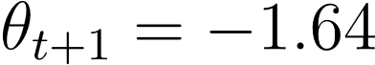
Neural Networks
How do we get a network to learn?
Gradient Descent.
Estimate the error.
Compute the change in weights most likely to reduce the error (gradient).
Update the weights according to the gradient.
= -36
start
Learning Rate
goal
= -2
Update Rule

Slide 118
Neural Networks
How do we get a network to learn?
Gradient Descent.
Estimate the error.
Compute the change in weights most likely to reduce the error (gradient).
Update the weights according to the gradient.
= -36
start
Learning Rate
goal
= -2
Update Rule

Slide 119
Neural Networks
How do we get a network to learn?
Gradient Descent.
Estimate the error.
Compute the change in weights most likely to reduce the error (gradient).
Update the weights according to the gradient.
start
goal

Slide 120
Neural Networks
How do we get a network to learn?
Gradient Descent.
Estimate the error.
Compute the change in weights most likely to reduce the error (gradient).
Update the weights according to the gradient.
start
goal

Slide 121
Neural Networks
How do we get a network to learn?
How do we choose lr (alpha)?
start
goal

Slide 122
Neural Networks
Building Blocks: Optimizer
How do we choose lr (alpha)?
Small lr will get caught in local minima.
start
goal

Slide 123
Neural Networks
Building Blocks: Optimizer
How do we choose lr (alpha)?
Small lr will get caught in local minima.
Large lr will never converge.
start
goal

Slide 124
Neural Networks
Building Blocks: Optimizer
How do we choose lr (alpha)?
Small lr will get caught in local minima.
Large lr will never converge.
start
Adam Optimizer
Separate lr for each parameter.
Update lr based on momentum.
Decay the lr over time.
goal

Slide 125
Neural Networks
Building Blocks: Optimizer
How do we choose lr (alpha)?
Small lr will get caught in local minima.
Large lr will never converge.
start
Adam Optimizer
Separate lr for each parameter.
Update lr based on momentum.
Decay the lr over time.
Sensitive to lr initialization.
Can be used with an overall decay as an upper bound.
goal

Slide 126
Neural Networks
Building Blocks: batch size
Gradient Descent.
Estimate the error.
Compute the change in weights most likely to reduce the error (gradient).
Update the weights according to the gradient.
How many samples should we see before we update the weights?

Slide 127

Neural Networks
Building Blocks: batch size
Gradient Descent:
Use all samples to compute the gradient and then update parameters.
Stochastic Gradient Descent:
Use one sample to compute the gradient and then update parameters.
Minibatch Stochastic Gradient Descent:
Use a subset of samples to compute the gradient and then update parameters.
14,197,122 samples in imagenet

Slide 128
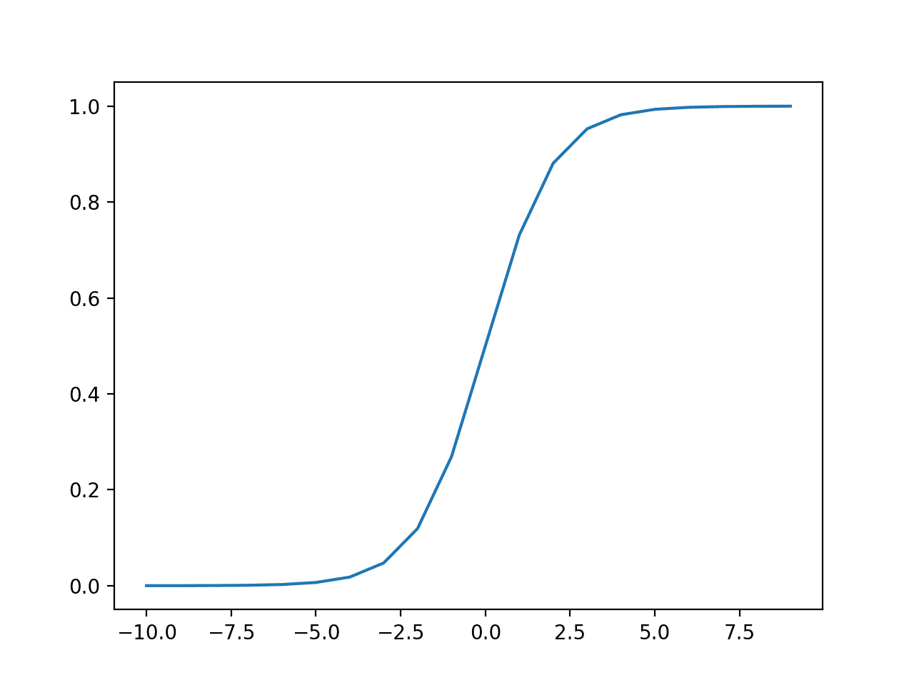
Neural Networks
Building Blocks: Activation Functions
Sigmoid
Used for RNNs and binary classification output
https://towardsdatascience.com/how-to-choose-the-right-activation-function-for-neural-networks-3941ff0e6f9c
https://machinelearningmastery.com/choose-an-activation-function-for-deep-learning/

Slide 129
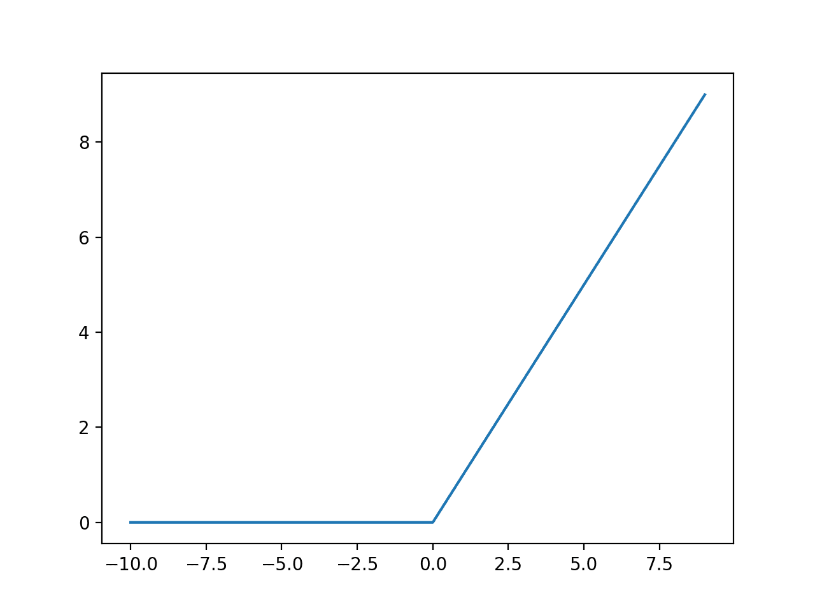
Neural Networks
Building Blocks: Activation Functions
Sigmoid
Rectified Linear Unit (ReLU)
Used for RNNs and binary classification output
Good general purpose fn, overcomes vanishing gradient issues
https://towardsdatascience.com/how-to-choose-the-right-activation-function-for-neural-networks-3941ff0e6f9c
https://machinelearningmastery.com/choose-an-activation-function-for-deep-learning/

Slide 130
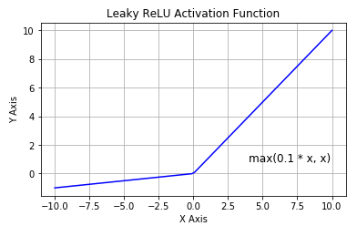
Neural Networks
Building Blocks: Activation Functions
Sigmoid
Rectified Linear Unit (ReLU)
Leaky ReLU
Used for RNNs and binary classification output
Good general purpose fn, overcomes vanishing gradient issues
Overcomes “dying relu”
https://towardsdatascience.com/how-to-choose-the-right-activation-function-for-neural-networks-3941ff0e6f9c
https://machinelearningmastery.com/choose-an-activation-function-for-deep-learning/

Slide 131
Neural Networks
Building Blocks: Output Layer
0/1
real
Binary Classification
Regression
Single Node
Sigmoid activation
Single Node
Linear activation

Slide 132
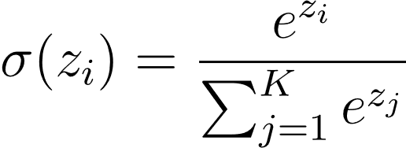

Neural Networks
Building Blocks: Output Layer
softmax
0/1
real
softmax
Binary Classification
Regression
Classification
Single Node
Sigmoid activation
Single Node
Linear activation
Multiple Nodes
ReLU activation with Softmax
Softmax converts multiple logits to probabilities

Slide 133

Diagnosing Neural Networks
Overfitting
Overfitting occurs when your network memorizes the training data.

Slide 134
Diagnosing Neural Networks
Overfitting
Overfitting occurs when your network memorizes the training data.
Prevent Overfitting:
Increase dropout. Dropout forces the network to learn multiple networks, increasing generalizability.
Reduce model depth.
Early stop training.

Slide 135
Neural Networks
Summary of Building Blocks
Fully Connected Layer: Every node is connected to every prior node.
Convolutional Layer: Apply a kernel to a sliding receptive field.
Max Pooling Layer: Select the largest value within the receptive field.
Softmax Layer: Rescale outputs for classification so that the outputs sum to 1.
Dropout Layer: Randomly removes nodes from a given layer.
ReLU Activation: Go-to standard activation function.
TanH Activation: Good activation for RNNs.
Sigmoid Activation: Output for binary classification. Good activation for RNNs.
Linear Activation: Output for regression.
Learning Rate: Size of gradient step.
Gradient Descent: Standard lr updates.
Adam Optimizer: Adaptive lr updates.
Batch Size: Number of samples to estimate the gradient

Slide 136
Preparing Your Data
“The literature on machine learning often reverses the meaning of ‘validation’ and ‘test’ sets. This is the most blatant example of the terminological confusion that pervades artificial intelligence research.” -MLM

Slide 137
Preparing Your Data
“The literature on machine learning often reverses the meaning of ‘validation’ and ‘test’ sets. This is the most blatant example of the terminological confusion that pervades artificial intelligence research.” -MLM
Train Set:
A set of examples used for learning, that is to fit the parameters of the classifier.
Validation Set:
A set of examples used to tune the parameters of a classifier.
Test Set:
A set of examples used only to assess the performance of a fully-specified classifier.

Slide 138
Preparing Your Data
“The literature on machine learning often reverses the meaning of ‘validation’ and ‘test’ sets. This is the most blatant example of the terminological confusion that pervades artificial intelligence research.” -MLM
DO NOT MIX THESE
Train Set:
A set of examples used for learning, that is to fit the parameters of the classifier.
Validation Set:
A set of examples used to tune the parameters of a classifier.
Test Set:
A set of examples used only to assess the performance of a fully-specified classifier.

Slide 139

Preparing Your Data
Proper way to split your data.
Train Set:
A set of examples used for learning, that is to fit the parameters of the classifier.
Validation Set:
A set of examples used to tune the parameters of a classifier.
Test Set:
A set of examples used only to assess the performance of a fully-specified classifier.

Slide 140
Diagnosing Neural Networks
Training Neural Networks is Hard :(
Incorrect Learning Rate:
Learning rate can have a strong impact on performance. Try adjusting the learning rate to aid convergence or adding a learning rate decay.
Forgot Data Normalization:
Networks typically perform better with normalized data.
Using large batch sizes:
Evidence suggests that overly large batch sizes inhibit learning.
Wrong Activation Function:
Some applications, e.g. Binary Classification, perform best with specific activation functions.
Network is too Deep:
Practically, deep networks are not always better. Start with a smaller network and grow it as needed.
https://arxiv.org/pdf/1206.5533.pdf
https://www.kaggle.com/general/196487
https://stats.stackexchange.com/questions/164876/what-is-the-trade-off-between-batch-size-and-number-of-iterations-to-train-a-neu

Slide 141
Diagnosing Neural Networks
Training Neural Networks is Hard :(
Incorrect Learning Rate:
Learning rate can have a strong impact on performance. Try adjusting the learning rate to aid convergence or adding a learning rate decay.
Forgot Data Normalization:
Networks typically perform better with normalized data.
Using large batch sizes:
Evidence suggests that overly large batch sizes inhibit learning.
Wrong Activation Function:
Some applications, e.g. Binary Classification, perform best with specific activation functions.
Network is too Deep:
Practically, deep networks are not always better. Start with a smaller network and grow it as needed.
Number One Cause of Network Failure:
Incorrect or improperly transformed input data.
Before training, be sure to inspect your input data, and visualize network inputs and outputs during training.
https://arxiv.org/pdf/1206.5533.pdf
https://www.kaggle.com/general/196487
https://stats.stackexchange.com/questions/164876/what-is-the-trade-off-between-batch-size-and-number-of-iterations-to-train-a-neu

Slide 142
Practicals

Slide 143
Operating Systems
Machine learning developers overwhelmingly use Linux.
The open source nature of Linux environments lends itself well to the complex installation and configuration processes required by many machine learning applications. Many machine learning algorithms are built on Linux already, fueling easy adoption.
https://medium.com/mlearning-ai/setup-deep-learning-environment-with-ubuntu-22-04-8ad40cb28f95

Slide 144
Operating Systems
Machine learning developers overwhelmingly use Linux.
The open source nature of Linux environments lends itself well to the complex installation and configuration processes required by many machine learning applications. Many machine learning algorithms are built on Linux already, fueling easy adoption.
WSL (Windows Subsystem for Linux):
Lets developers run a GNU/Linux environment -- including most command-line tools, utilities, and applications -- directly on Windows
https://medium.com/mlearning-ai/setup-deep-learning-environment-with-ubuntu-22-04-8ad40cb28f95

Slide 145

Development Environment
Dependencies
We’ll be using python to code our Neural Network
Effective python coding requires managing your dependencies
ML is usually taught using Colab, which does this (mostly) for you

Slide 146

Development Environment
Dependencies
We’ll be using python to code our Neural Network
Effective python coding requires managing your dependencies
ML is usually taught using Colab, which does this (mostly) for you

Slide 147

Development Environment
We’ll be using python to code our Neural Network
Effective python coding requires managing your dependencies
ML is usually taught using Colab, which does this (mostly) for you

Slide 148

Development Environment
Dependencies
Most dependencies are installed with PIP (pip installs packages)
Interfaces with the Python Package Index

Slide 149
Environments (containerization)
For real applications, you’ll need to install your own dependencies.
We do this inside a virtual environment.
python environment
numpy
torch
pandas

Slide 150
Environments (containerization)
For real applications, you’ll need to install your own dependencies.
We do this inside a virtual environment.
python environment
numpy
torch
pandas
Why is this good?
You can instruct people how to install your dependences.
You can work on multiple projects at the same time.
When you inevitably screw something up, makes it easy to start over.

Slide 151
Environments (containerization)
For real applications, you’ll need to install your own dependencies.
We do this inside a virtual environment.
virtualenv:
Python package manager bundled with python. Sufficient for most projects.
anaconda:
System package manager with a gui. Useful for installing complex dependencies that extend beyond python.
docker:
Machine-level virtualization. Useful for installing and distributing projects with extremely complex dependencies.
Why is this good?
You can instruct people how to install your dependences.
You can work on multiple projects at the same time.
When you inevitably screw something up, makes it easy to start over.

Slide 152
Tools
VSCode:
Lightweight IDE replacement that is extremely popular for python programing with an extensive extensions library.
Screen:
Enables training “in the background”.
Virtualenv:
Python environment containerization.

Slide 153
Tools
VSCode:
Lightweight IDE replacement that is extremely popular for python programing with an extensive extensions library.
Screen:
Enables training “in the background”.
Virtualenv:
Python environment containerization.
Remote Explorer (VSCode Extension):
Connect to remote servers through VSCode.
Pylance (VSCode Extension):
IntelliSense for python.

Slide 154

Tools
VSCode:
Lightweight IDE replacement that is extremely popular for python programing with an extensive extensions library.
Screen:
Enables training “in the background”.
Virtualenv:
Python environment containerization.
Remote Explorer (VSCode Extension):
Connect to remote servers through VSCode.
Pylance (VSCode Extension):
IntelliSense for python.
PyTorch:
Machine learning framework based on the open-source torch library.

Slide 155

Using Virtual Environments
virtualenv

Slide 156
Using Virtual Environments
virtualenv

Slide 157
Using Virtual Environments
virtualenv

Slide 158
Using Virtual Environments
virtualenv

Slide 159

Using Virtual Environments
virtualenv
Every project should come with a requirements.txt file

Slide 160

Using Virtual Environments
virtualenv
Every project should come with a requirements.txt file
To create a requirements.txt file:

Slide 161
Using Virtual Environments
virtualenv
Every project should come with a requirements.txt file
To create a requirements.txt file:

Slide 162
Coding

Slide 163
Using Virtual Environments
virtualenv
Every project should come with a requirements.txt file
To create a requirements.txt file:

Slide 164
Using PyTorch
Data
Model
Training Loop

Slide 165

Using PyTorch
Data
Model
Training Loop
The dataset handles loading and transforming the input data.
Must implement the __len__ and __getitem__ methods.

Slide 166

Using PyTorch
Data
Model
Training Loop
Model defines the network you’re going to use.
Must implement the forward method.

Slide 167

Using PyTorch
Data
Model
Training Loop
The training loop does the following:
Set model mode to train
Iterate over the data and:
Reset the gradients
Pass the data through the network
Compute the loss
Perform backpropogation
Take a gradient step
https://pytorch.org/tutorials/beginner/basics/quickstart_tutorial.html

Slide 168
Resources
Machine learning mastery list of all tutorials:
https://machinelearningmastery.com/start-here/#statistical_methods
Stanford introduction to Deep Learning:
http://ufldl.stanford.edu/tutorial/
Neural Networks and Deep Learning:
http://neuralnetworksanddeeplearning.com/chap1.html
Deep Learning Specialization:
https://www.coursera.org/specializations/deep-learning
Convolutional Calculator:
https://madebyollin.github.io/convnet-calculator/

Slide 169
Figure Creation Resources
Neural Network Diagram Maker:
https://alexlenail.me/NN-SVG/index.html
Common Latex Formulas:
https://blmoistawinde.github.io/ml_equations_latex/#softmax
Latex Compiler:
https://latex.codecogs.com/eqneditor/editor.php

